Slide 1
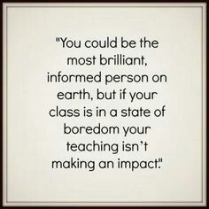
LSUA CTE - 2022

Slide 2
How to Make Classrooms More Engaging Using Simple Assessments to Formative Assessments
Sarah Barnes & Sona Kumar
LSUA CTE - 2022

Slide 3
Learning-Centered Teaching:
Allowing Students to be in the Driver’s Seat
Sarah Barnes
Center for Teaching Excellence Conference 2018
Fall 2018

Slide 4
Let’s Keep it Simple…Increasing Engagement using Simple Assessments while in the Classroom

Slide 5
Objective:
Discuss & create ways to initiate more engagement from our students to inspire deeper learning.

Slide 6
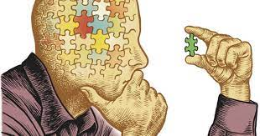
Guided Reflective Practice (GRP)
Thinking with Things

Slide 7
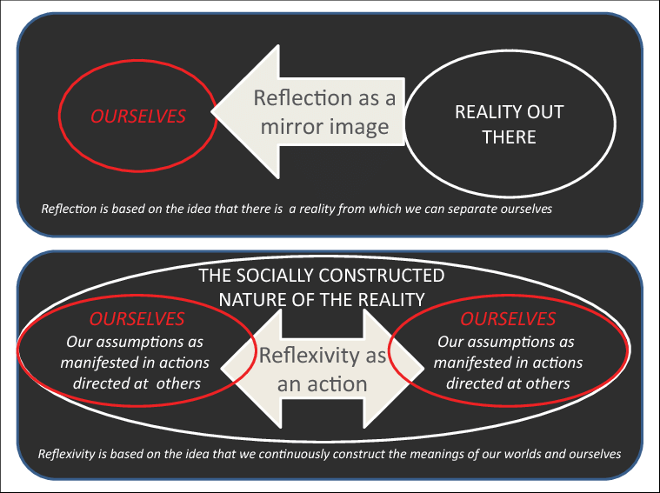
Reflection vs. Reflective Practice

Slide 8
John Dewey (RP)
Scott Greenberger (GRP)
What? Why? How did I feel? What did I learn? What will I do differently next time?
Questioning why things are as they are and thinking how they can be done differently.
Continuously learning everyday behavior while testing them out (learning with experience - on the job training).
Reflection usually stops after the experience…true reflection comes after the experience
Intro to Reflective Practice

Slide 9
Benefits:
Conscious of bias and discrimination
Look at things from different perspectives
Avoid past mistakes
Challenged practice to improve
Maximize opportunities for learning
Active process
Keep skills up to date
Cyclical process
Reflective Practice

Slide 10
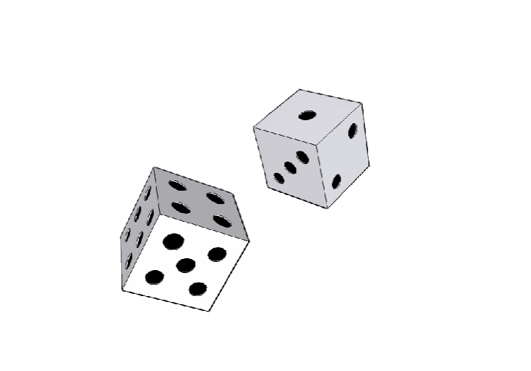
Reflective Practice: Self Assessment Tools in the Classroom
Amy Anderson & Kelly Maguire
Di Breaker
Roll di
Each # goes with a question on the board/ppt/paper
What can the numbers represent?
(1) Experience an activity
(2) Share an activity
(3) Process of an activity
(4) Generalize with real world examples
(5) Application - how can you take what you learned and apply it?

Slide 11
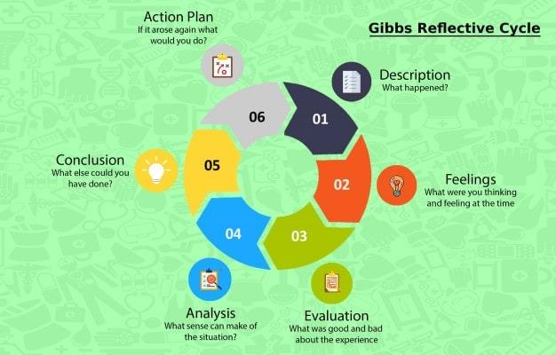
Patient Care: Difficult Patient?

Slide 12
Reflective Practice: Self Assessment Tools in the Classroom (cont.)
Amy Anderson & Kelly Maguire
EXAMPLE:
How do you incorporate reflection in your teaching?
Why is reflection useful for assessing student learning?
What assignments do you assign that could benefit from a reflective assessment?
How do your students currently self-assess in your class?
What are the benefits of self-assessment?
Have you ever used a structured reflection guide before?

Slide 13
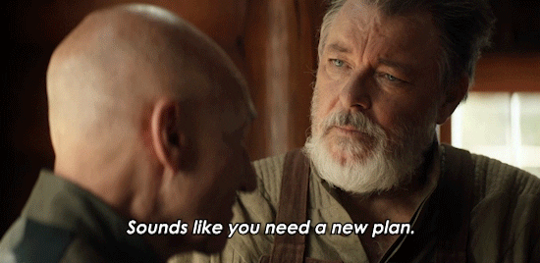

Slide 14
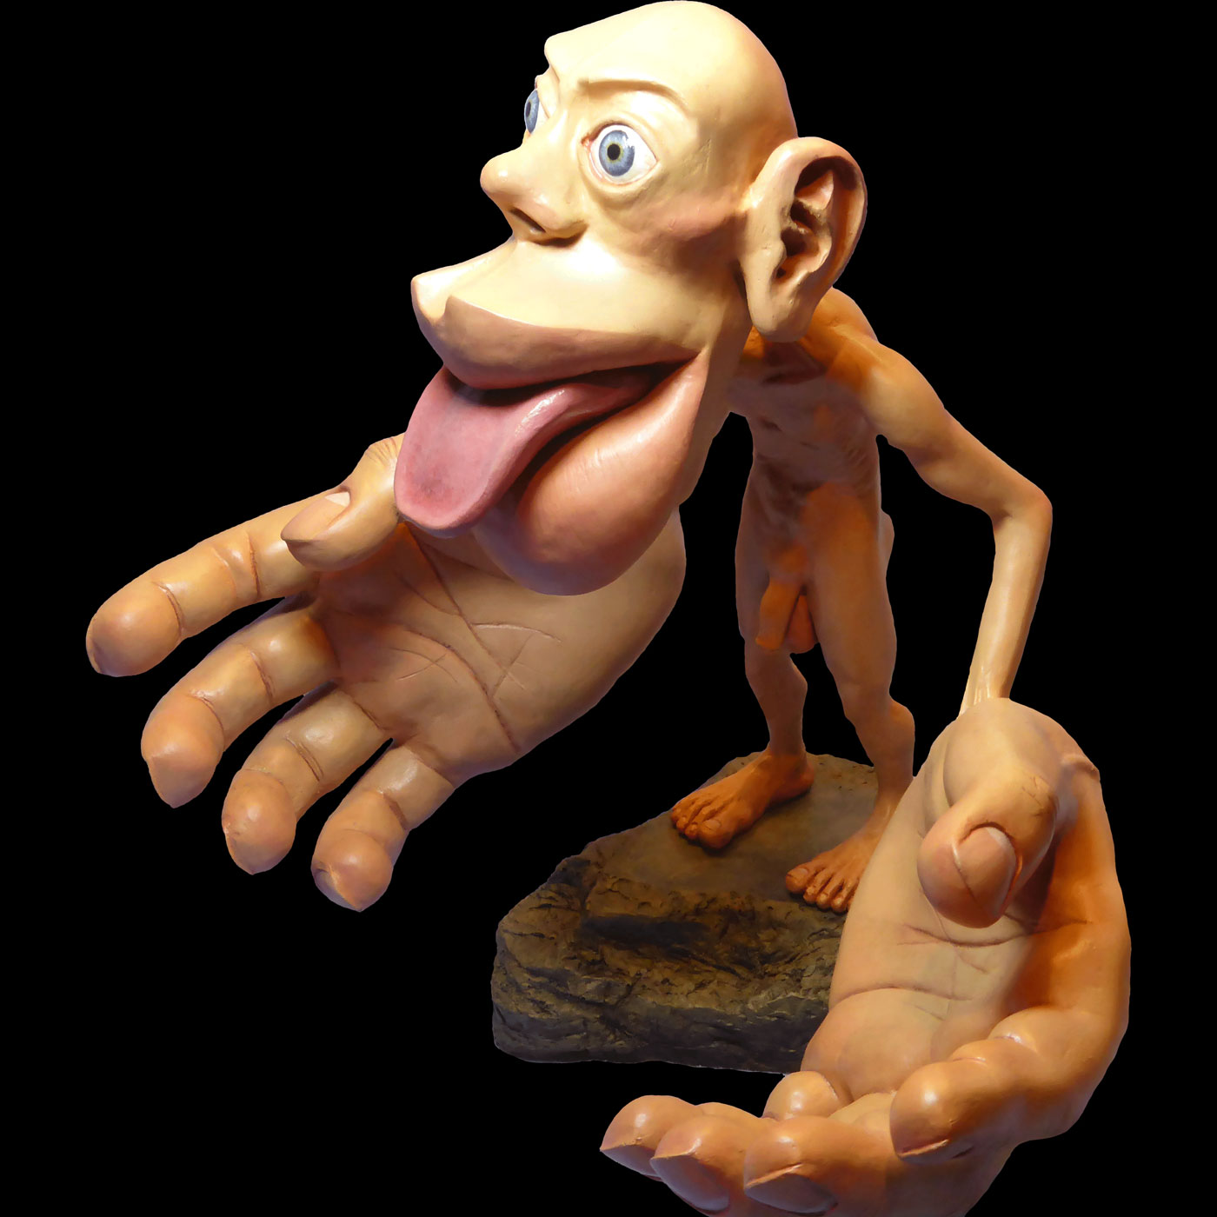
Thinking with Things: Background
Think with our bodies and environments
Conventional classrooms - “sensory deprivation chambers”
Physical space - shape plays a big role in how and what we teach
“Thing” includes both digital & nondigital
“The attention of the expert must be focused on the task at hand, not the tool itself…the tool becomes an appendage of the expert’s body, a tacit from which to experience the world.” (Polanyi, 1983/166; Kuhn & Davidson, 2007)
Figures - hands and mouth are bigger, why?

Slide 15
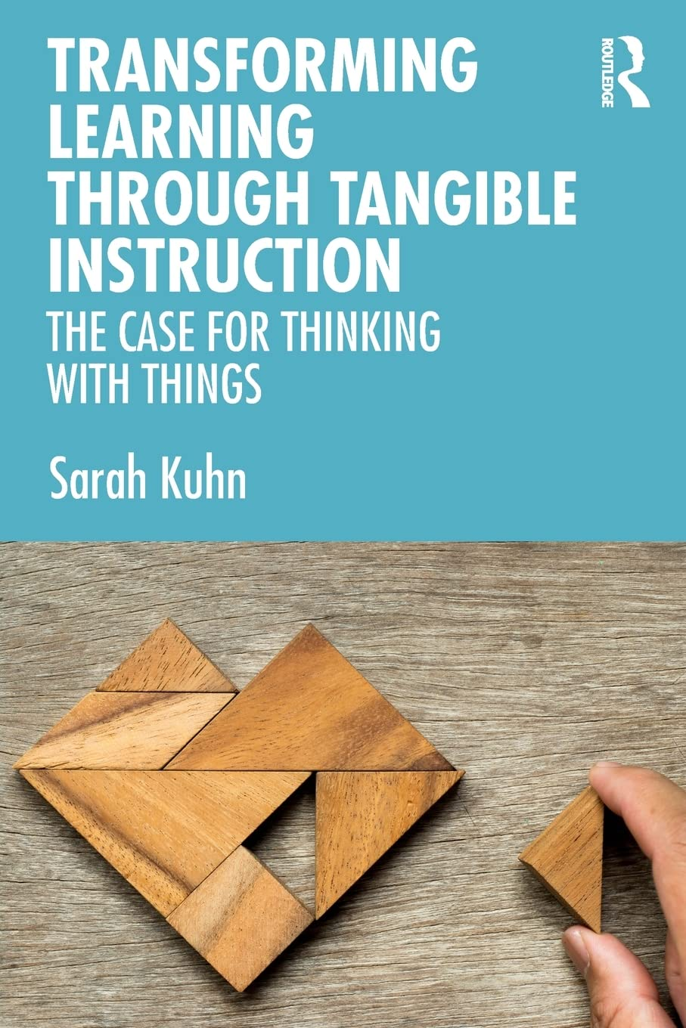
Thinking with Things
Dr. Sarah Kuhn
We manipulate with and interact with our hands
Very low cognitive activities decreases mind wondering
Ex: drawing
Boring survival kits
Knitting
Doodling
Fidget spinner
Other items
Flip chart
Tinker toys
Blocks
Play-Doh

Slide 16
Benefits:
Support reflection and different learning styles.
Make the difficulties of the research design process public, thus normalizing them.
Students become a learning community.
A valuable artifact is created.

Slide 17
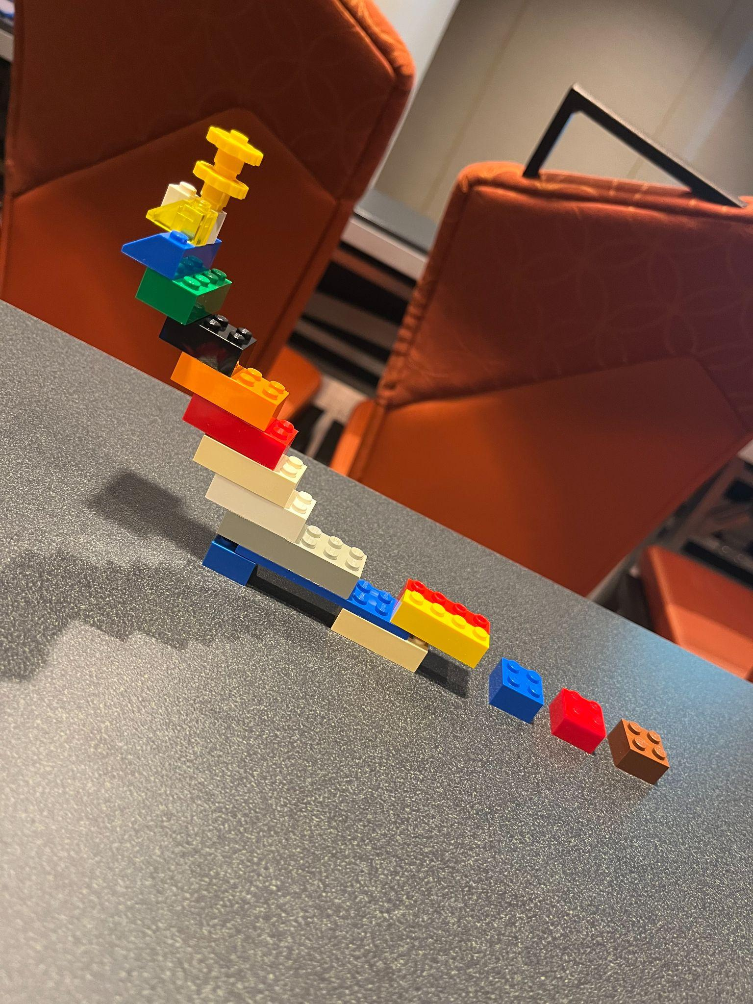
Thinking with Things (cont.)
Dr. Sarah Kuhn
Challenge 1:
What learning challenge would you like to get help with? Build something that can help you describe this challenge.

Slide 18
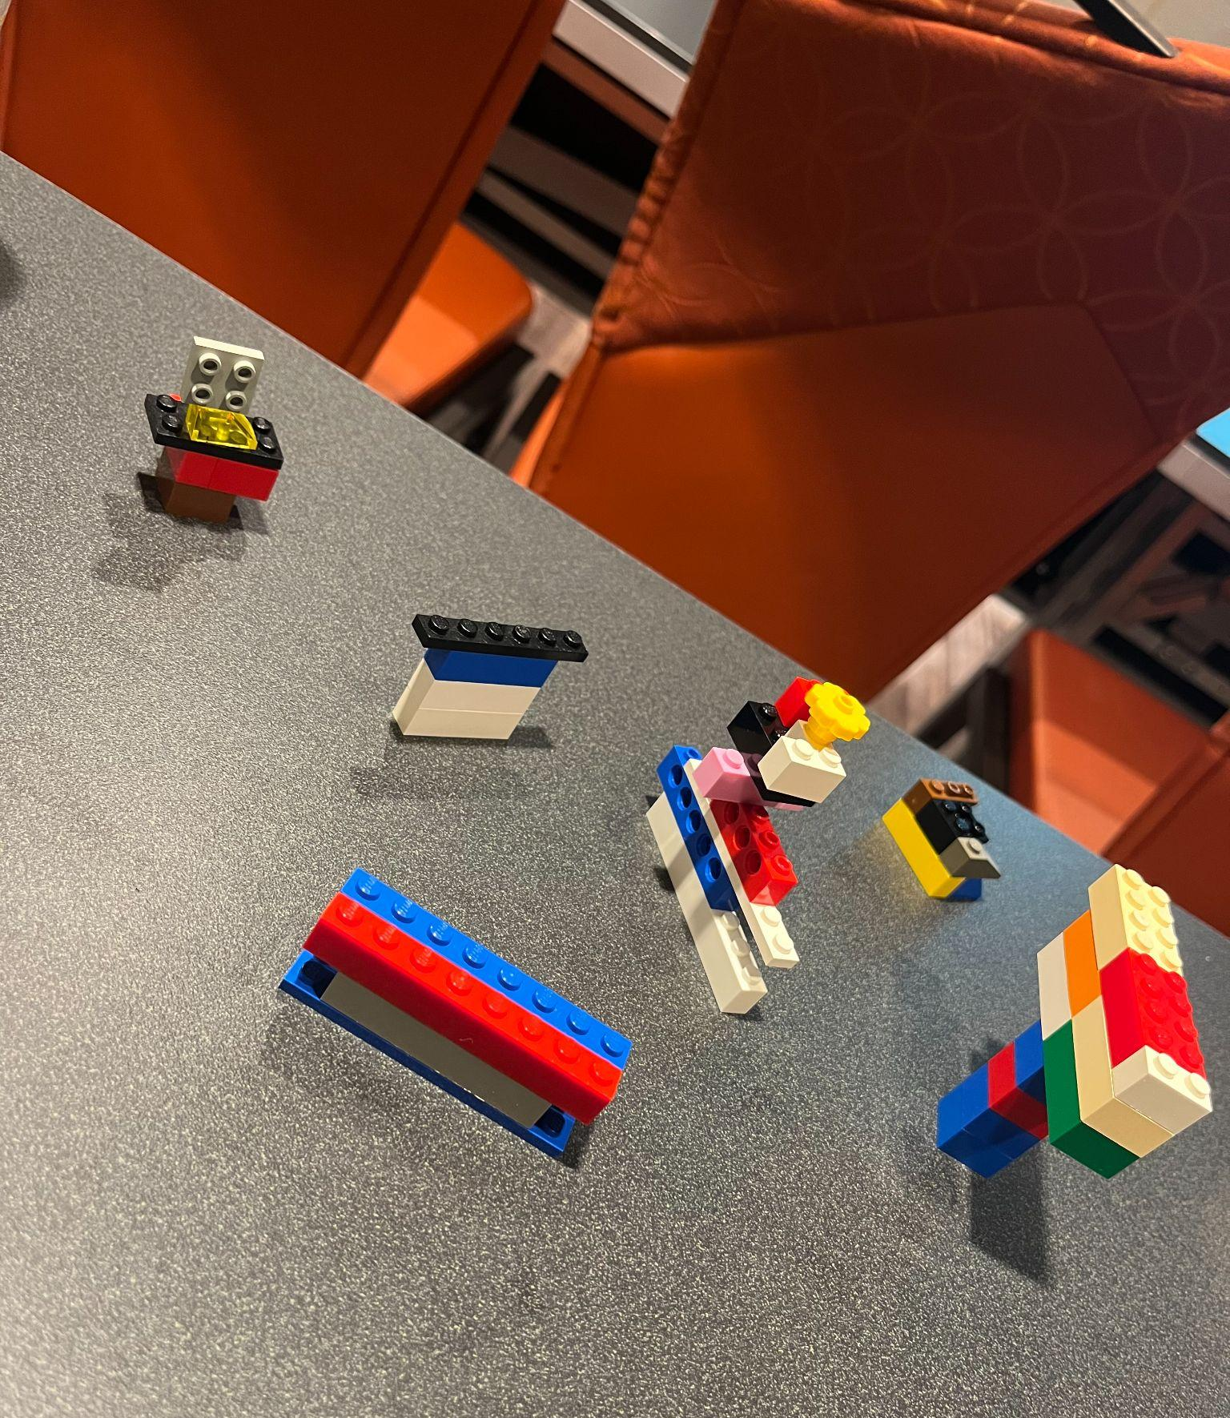
Thinking with Things (cont.)
Dr. Sarah Kuhn
Challenge 2:
Your department has decided to embrace a thinking with things approach. Create a logo sketch of one example of how you might teach a concept in your discipline.
Tube, Patient, x-ray table
Door to the room
Wall and window
Wall unit
Stretcher

Slide 19
Rad Tech - In Class Activities:
Physics Scenario
Describe the layers of an imaging plate. Explain each section. Will this increase or decrease patient dose? Will this increase/decrease spatial resolution?

Slide 20
Rad Tech - In Class Activities:
Patient Care Scenario
Think about an ethical violation related to radiology and patient care. What happened & what are the results?
Physics Scenario
Describe the process of x-ray production (latent image to manifest image). CR vs. DR.

Slide 21
When can you use this in your course?
Bell Ringers (beginning of class)
Exit Ticket (end of class)
When things are getting boring…
After chunking information…
Exam reviews
Semester reviews
What other times can you think of?

Slide 22
References
Anderson, A. & Maguire, K. (2022, June 5). Guide for reflective practice:
Self-assessment tool in the classroom [Conference session]. The Teaching
Professor Conference 2022, Atlanta, Ga, United States.
Kuhn, S. (2022, June 5). Thinking with things: Creating an engaging and effective
classroom experience [Conference session]. The Teaching Professor
Conference 2022, Atlanta, Ga, United States.
Kuhn, S. & Davidson, J. (2007). Thinking with things, teaching with things.
Qualitative Research Journal, 7(2), 63-75.

Slide 23
Any
Questions

Slide 24
Sarah Barnes, MBA, RT, (R)(CT)
Assistant Professor, Clinical Coordinator
Radiologic Technology Program,
Dept. of Allied Health, LSUA
sbarnes@lsua.edu

